Slide 1
April,2021
Biomedical Committee – Biomedical Equipment Starter Pack
Session (5) : Ultrasound
Prepared by: Mohamed Ahmed Abdelaziz

Slide 2
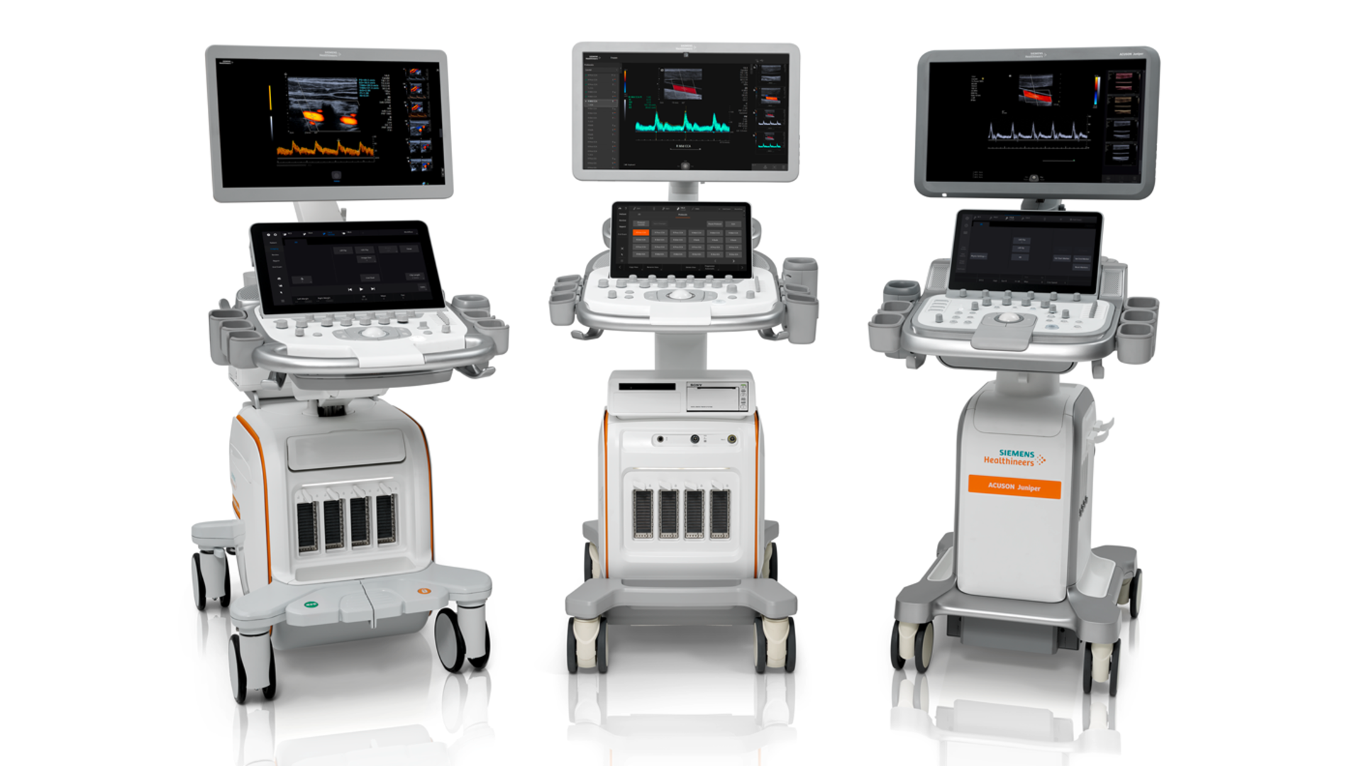
Ultrasound

Slide 3
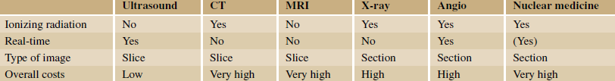
Why Ultrasound ?
Quick
Simple
Cost efficient
Mobility
Used nearly in all the medical specialties
No ionized radiation

Slide 4
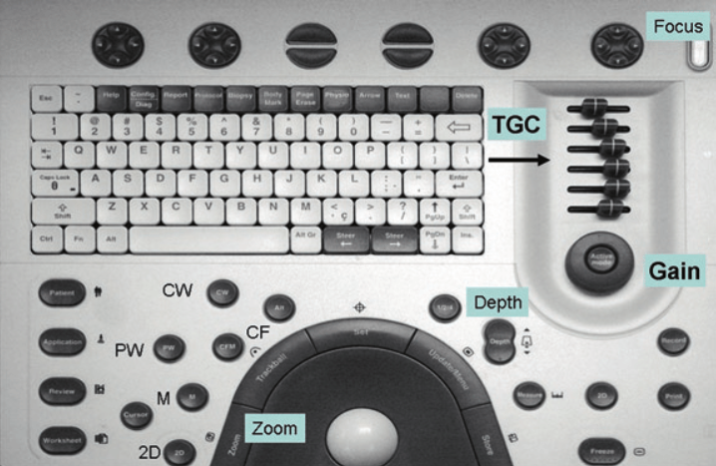
Control Panel

Slide 5
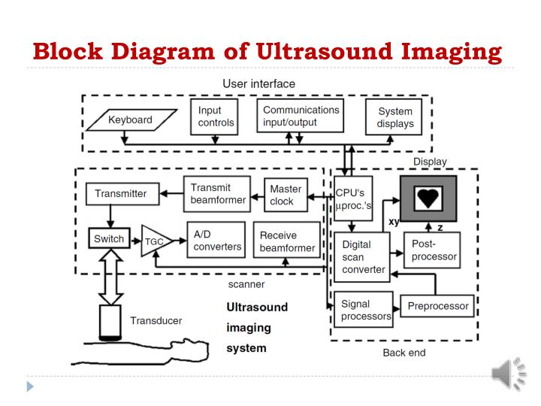
Block diagram

Slide 6
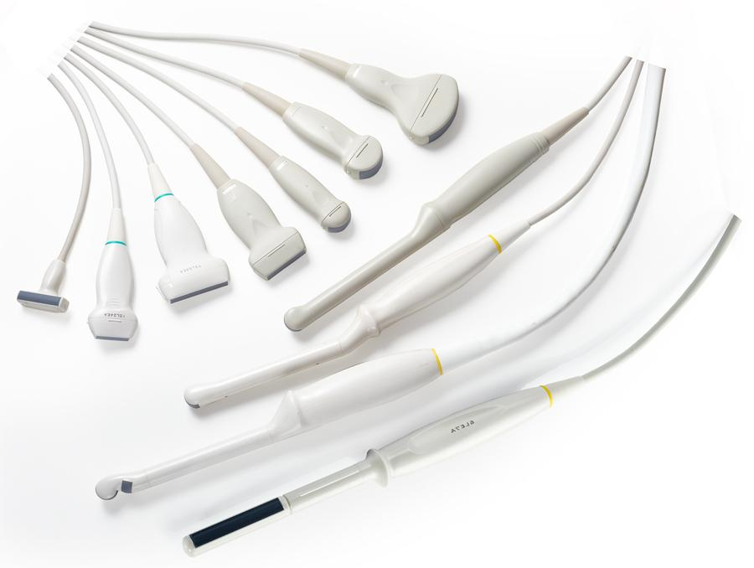
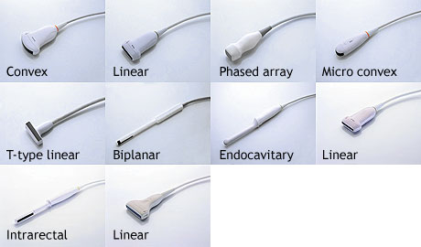
Transducers

Slide 7
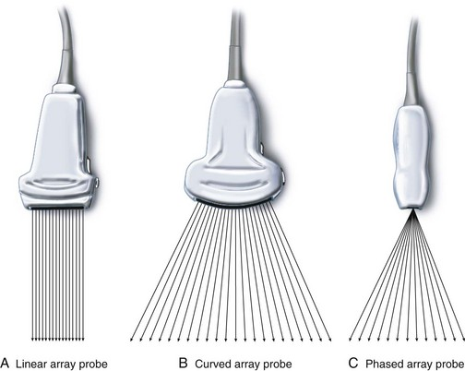
Scan Lines

Slide 8
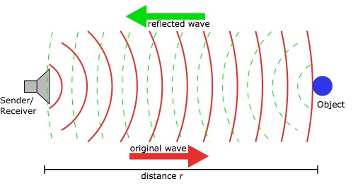
Echo Ranging
t = d/c
t = 2d/c
t = 0

Slide 9
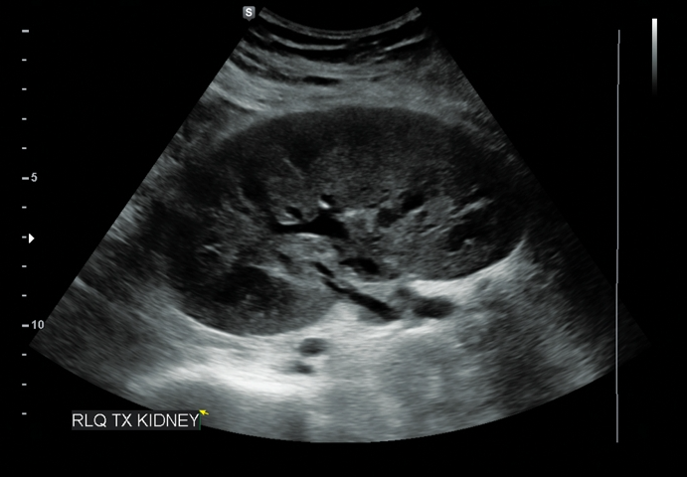
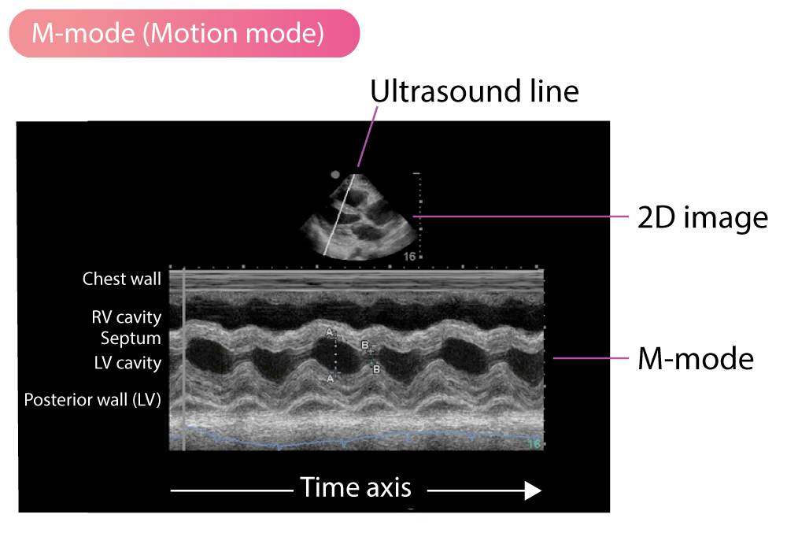
B-Mode & M-Mode
B-Mode: brightness modulated image in which the depth is presented along the scan line (depending on the time it take to return to the transducer)with shades of gray corresponding to the intensity of the echo.
M-Mode: Time history of single line at the same position over time.

Slide 10
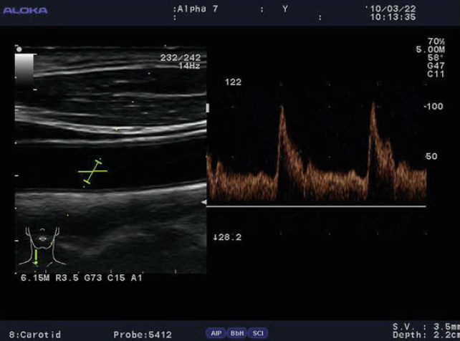
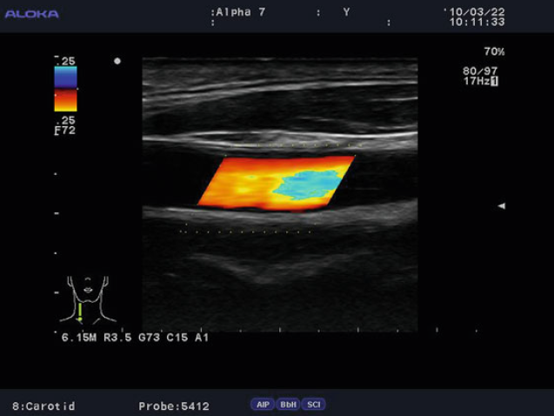
Doppler-Mode
Doppler Imaging represent the Doppler Spectrum (Frequency Shift)
Spectral Doppler
Continuous wave
Pulsed Wave
Color Doppler
Velocity Doppler
Power Doppler

Slide 11
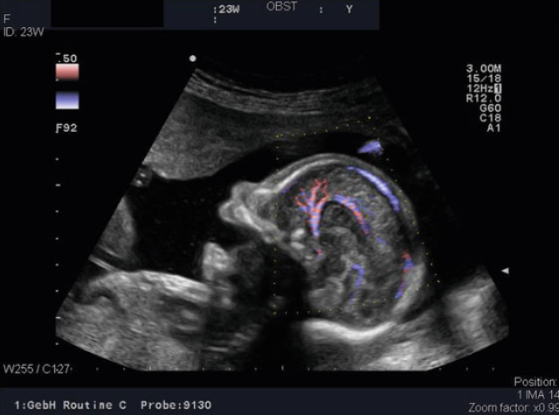
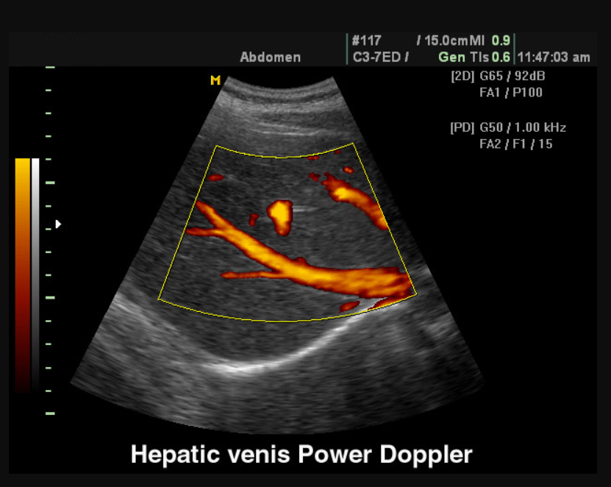
Velocity mode: Spatial map overlaid on a B-mode gray-scale image to show the blood flow mean velocity. Direction of flow encoded in colors blue away from the transducer and red toward it
Power mode: color-coded image is based on intensity rather than on direction of flow

Slide 12
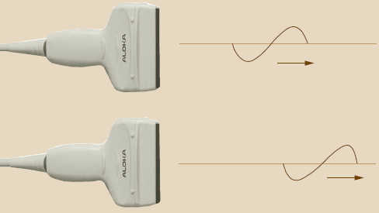
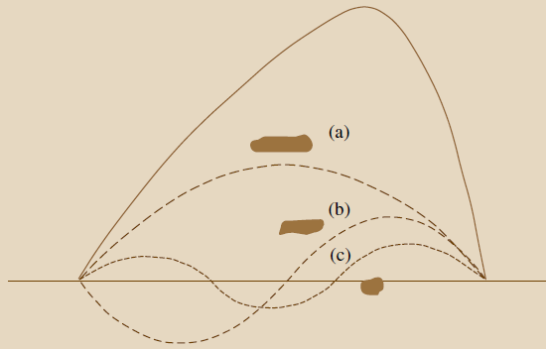
THI (Harmonic Imaging)
The pulses from an ultrasound unit emitted into the body also experience deformation on their path through the tissue. As the distance from the crystal increases the shape of the wave increasingly resembles a saw-tooth.
The higher the intensity of the sound emitted, the earlier and more pronounced this deformation.
Every non sinusoidal oscillation can be broken down into multiple sinusoidal oscillations of different frequencies by means of Fourier analysis.
signal processing suppresses the higher-frequency signal components, so that the dominant fundamental of each reflected signal is primarily used for imaging (Second Harmonic).

Slide 13
Advantages
clearer differentiation between liquid and solid tissues. (more deformation in tissue)
the amplitude of the interfering side lobes which occur automatically at the fundamental frequency is too low to generate overtones.
Provide more clarity imaging liquid-filled cavities in particular, such as the amniotic
cavity, the bladder, the cardiac cavities or cysts.
Disadvantages
the reflected second harmonic has less penetrative power as a result of the doubling in the frequency.

Slide 14
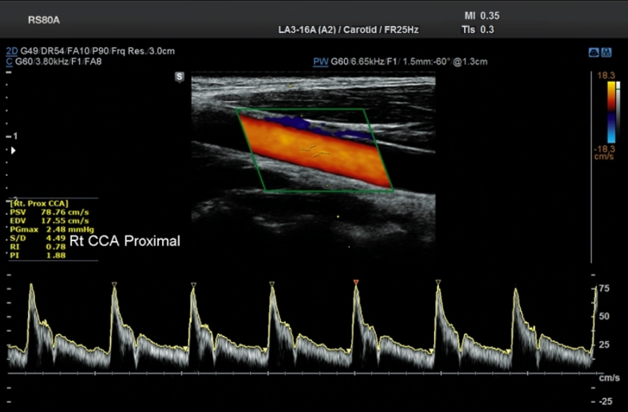
Secondary Modes
Duplex
Triplex
3-D & 4-D
THI
TDI
Electrography
Fusion

Slide 15
Task1
Electrography
Tissue Doppler imaging
Fusion technology
Panoramic image

Slide 16
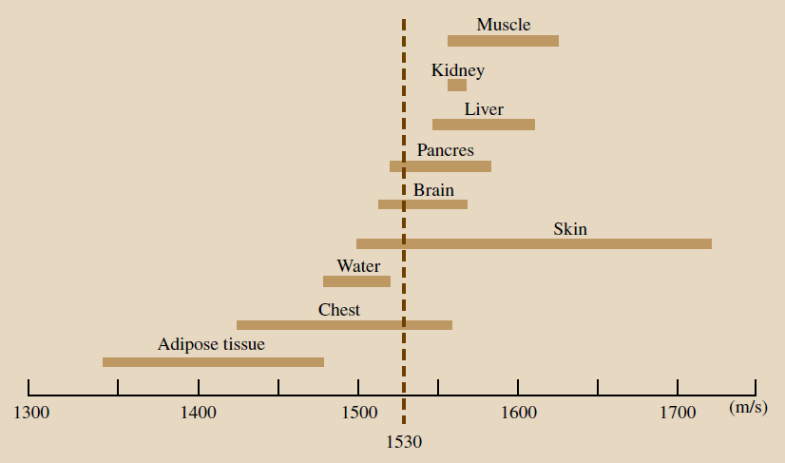
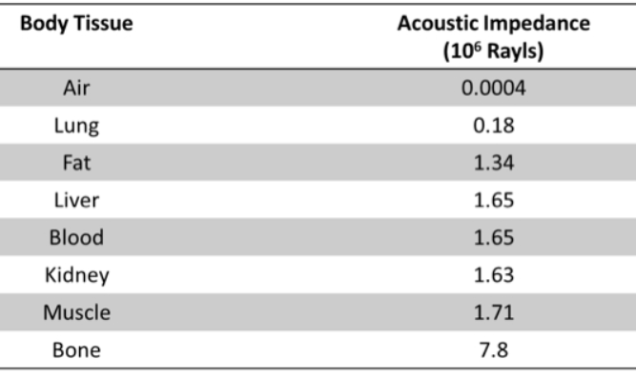
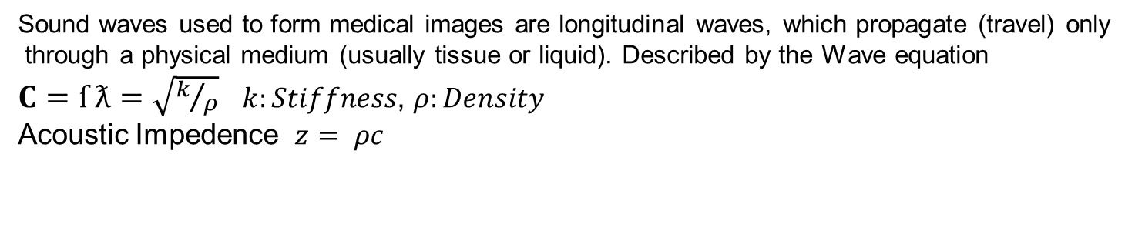
Ultrasound Physics
Sound waves used to form medical images are longitudinal waves, which propagate (travel) only
through a physical medium (usually tissue or liquid). Described by the Wave equation
$C=ſ ƛ=\sqrt{k/ρ}$ $k:Stiffness$, $ρ:Density$
Acoustic Impedence $z= ρc$

Slide 17
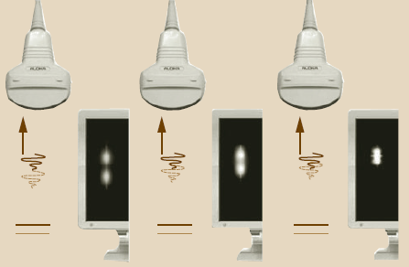
Ultrasound Physics
Medical ultrasound frequencies used in the range 2–15 MHz
Axial Resolution proportional to wavelength. (half pulse length)
Penetration is reversely proportional to the frequency. (more interfaces and details can be seen as the freq. increase)

Slide 18
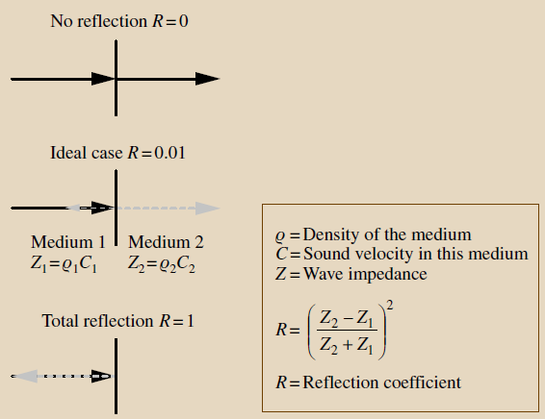
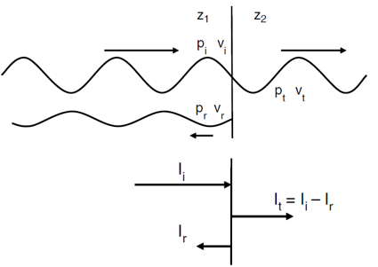
Reflection
If Z1 is smaller than Z2 the reflection coefficient (R) increases and less power travel through the tissue
And so the shadowing occur. Why Using Gel ?
High water content with R nearly 0

Slide 19
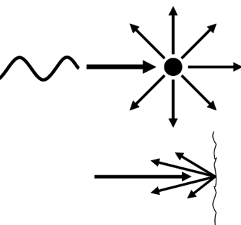
Scattering
Small Interfaces (size less than wavelength)
Ultrasonic power scattered back is small compared to reflections
Beam angle-independent appearance in the image unlike reflection
Diffuse Reflection: Rough Surfaces
Scattering profile differ from one tissue to the other
Speckle: Random yet stationary pattern

Slide 20
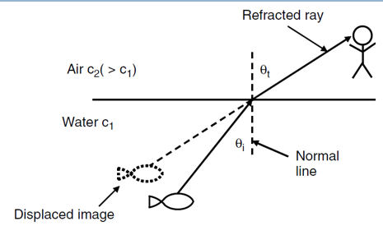
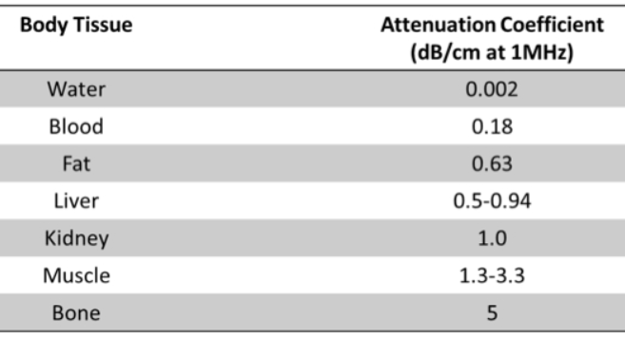
Refraction & Attenuation

Slide 21
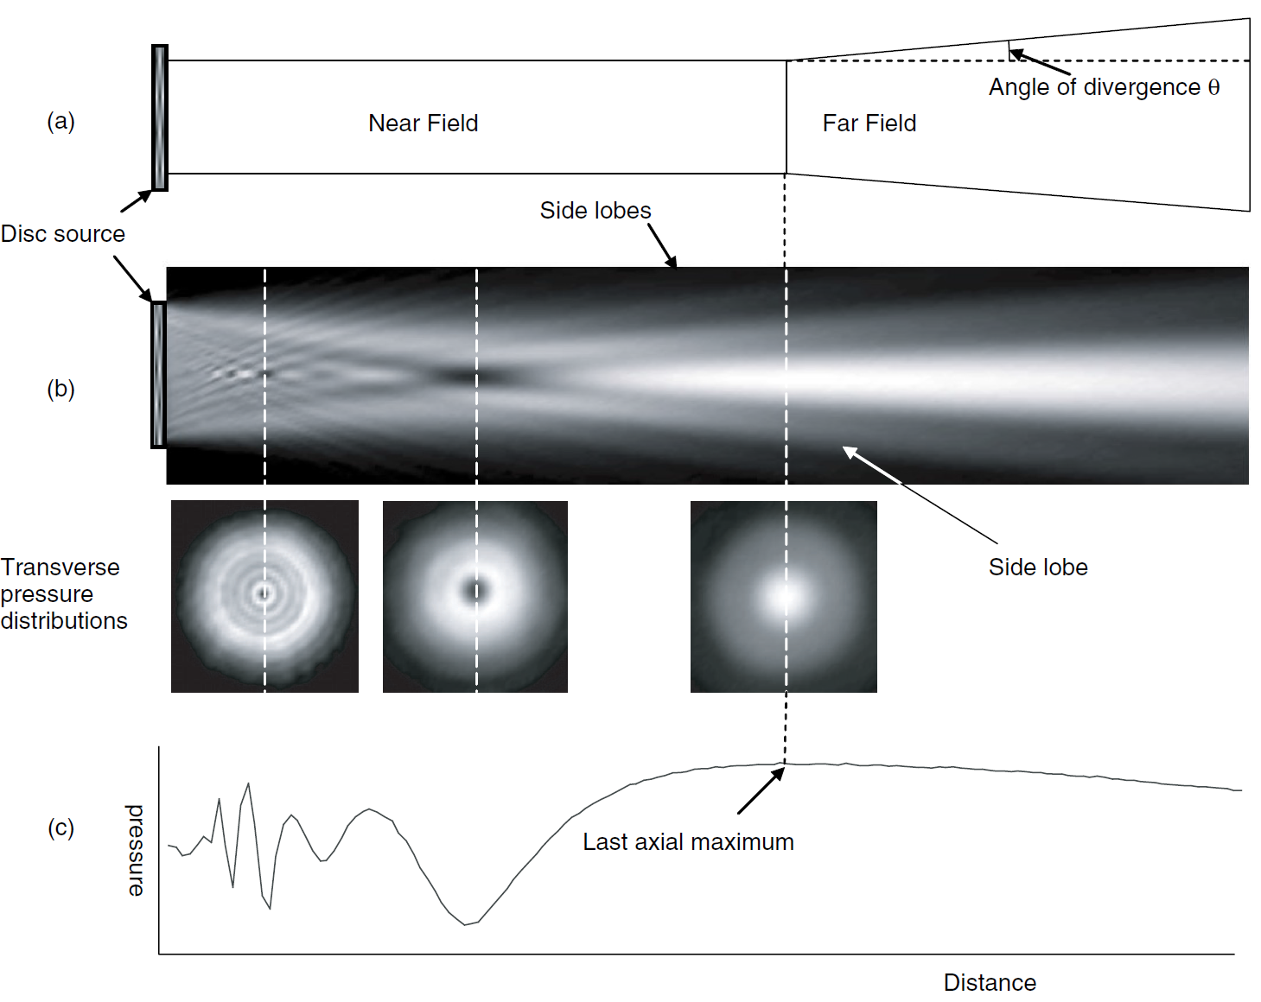
Interference & Diffraction

Slide 22
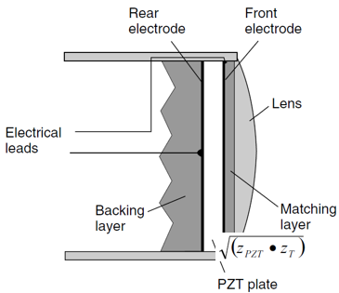
Transducers
Transducer: converts electrical transmission pulses into ultrasonic pulses and, conversely, ultrasonic echo pulses into electrical echo signals
Backing layer: Is used to damp the sound wave in order not to affect the crystals and the image quality.
Focusing lens: to focus the beam in the elevation direction
Focusing may also be presented electronically .
Matching layer: cause the reflected sound waves to cancel out each other

Slide 23
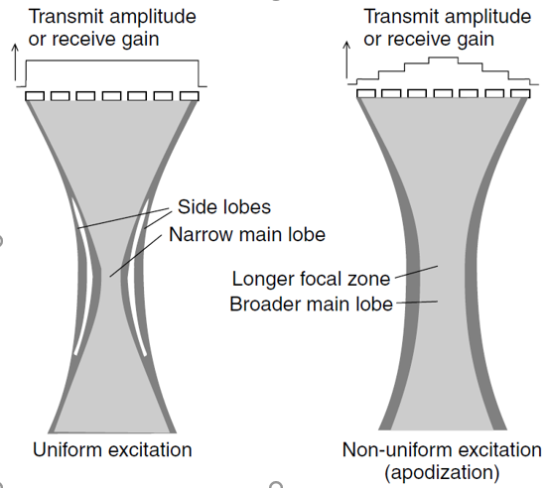
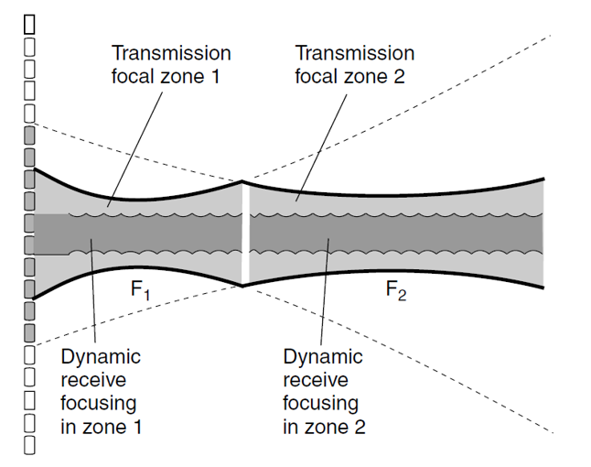
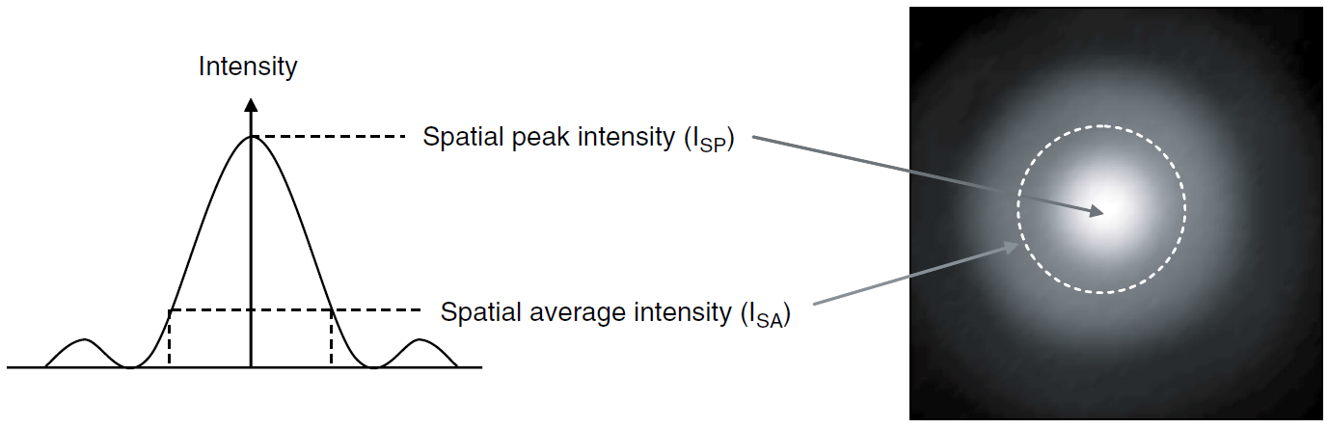
Beamforming & Transmission Zones
Beam shape is the Fourier transformation of the transducer gate . For a uniform excitation the profile
Is represented by Sinc beam shape (contain Side lobes) which cause image artifacts
Solution is by (apodization), but it also affect the
Lateral resolution(bluring).
Transmission zones: mean to acquire the same line with
Different focal zones and combine them together. This
Affect the time of the scan and the FPS
Note : Active elements which acquire a line the shifted
To acquire the next to form the image takes nearly
(1/20 s ) => 20 FPS (real time)

Slide 24
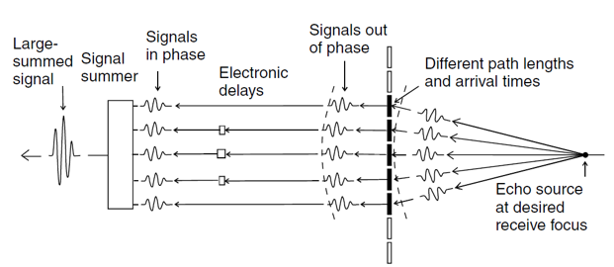
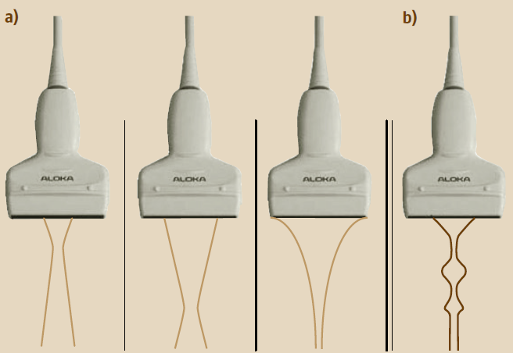
Reception Focusing

Slide 25
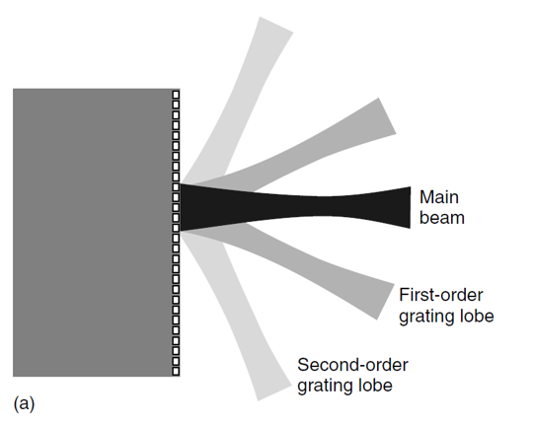
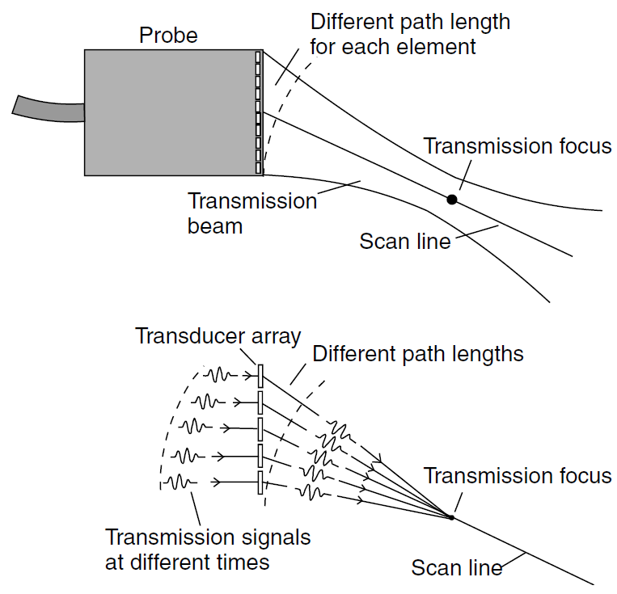
Beamforming
Grating Lobes: No grating lobes, if the center-to-center distance between elements is half a
wavelength or less.
Electronic steering/focusing

Slide 26
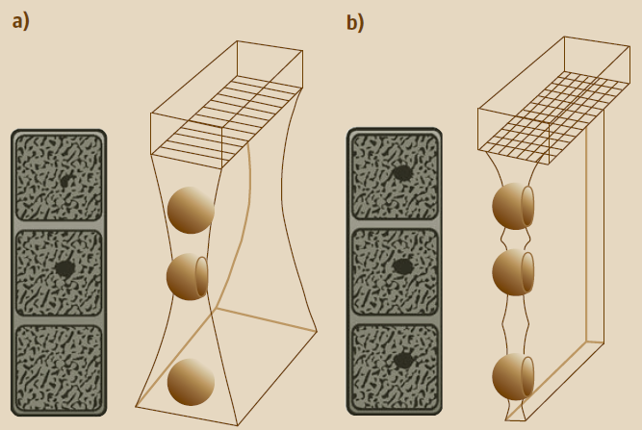
1.5 D & 2D array transducer
Thickness resolution

Slide 27
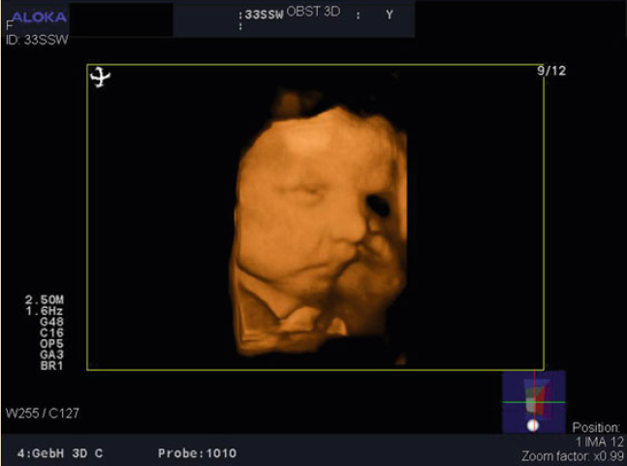
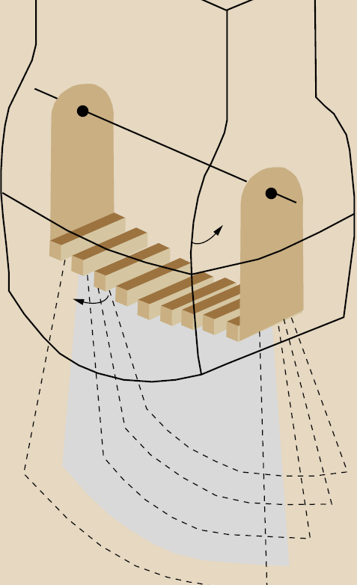
3D & 4D

Slide 28
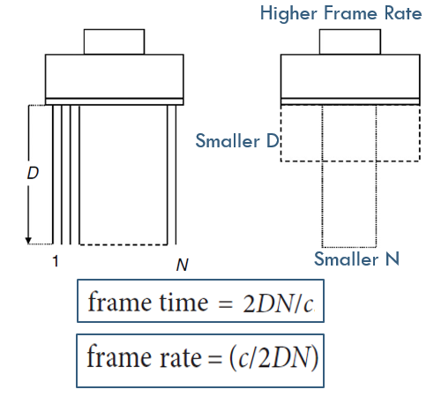
Frame Rate
Time to scan a complete image (usually 1/20 s) = 20 FPS

Slide 29
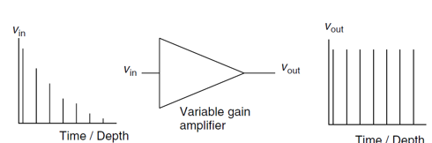
Time Gain Compensations (TGC)

Slide 30
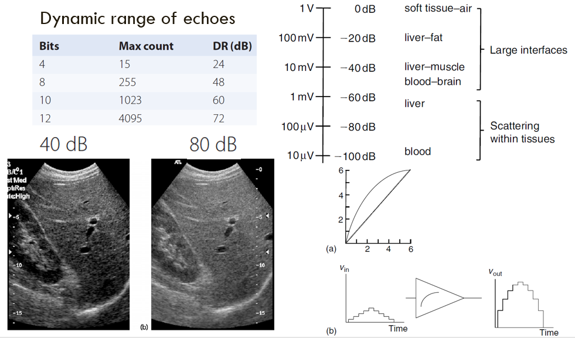
Dynamic Range
The higher the DR the better detectable small intensity echoes with better contrast
to detect the blood we need 100dB
Interfaced are constructed with nearly 40 dB
Solution is done using dynamic range compression (logarithmic amplifier )
Uniform gain is not suitable, but if small echoes are amplified more than large echoes then small echoes are better detectable

Slide 31
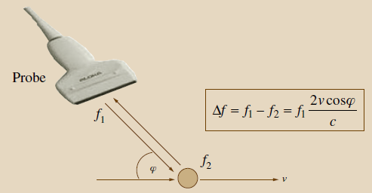
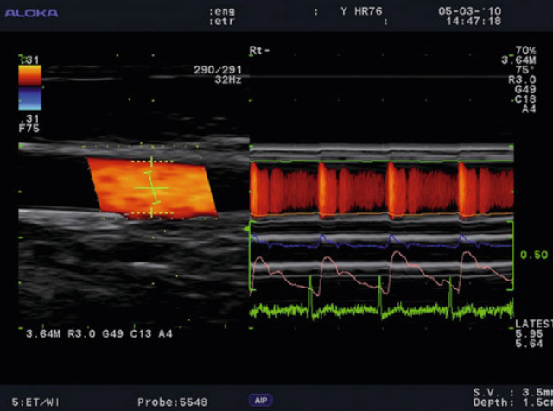
Doppler Ultrasound
RBCS in blood are hardly visible in ultrasound images
Real time calculations and analysis

Slide 32
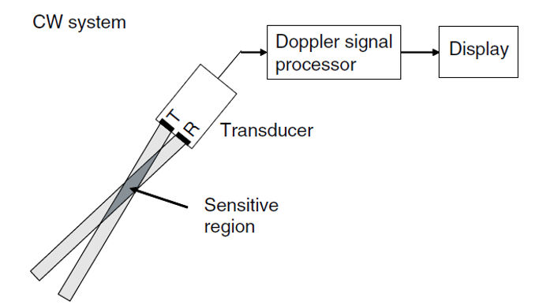
CW Doppler
Only a small region for Doppler sensitivity
No range information
No limitation on maximum velocity and high velocity accuracy

Slide 33
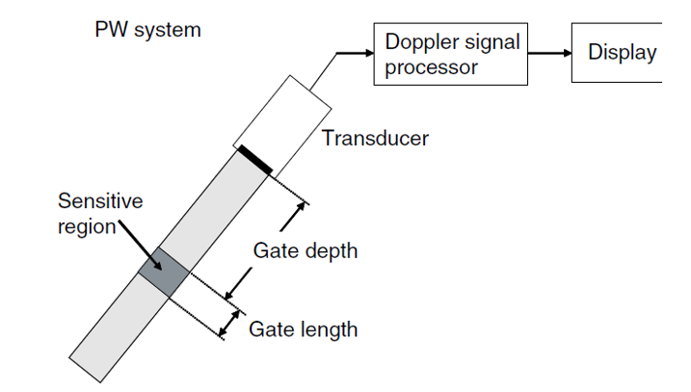
PW Doppler
Range information is available and region is selectable by user
Limitations on maximum velocity and accuracy

Slide 34
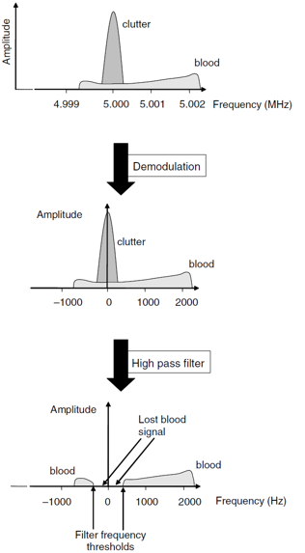
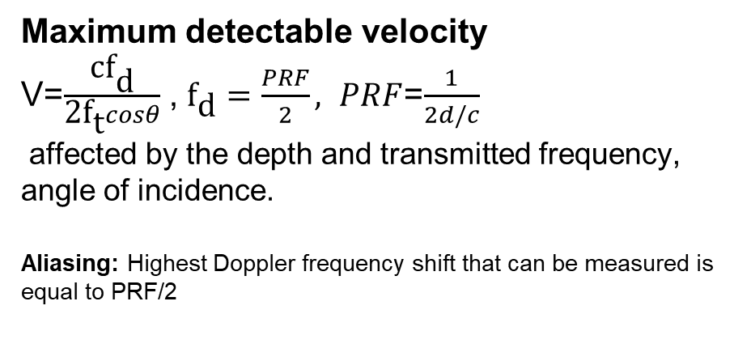
Clutter
Signal from Stationery tissue and wall motion
Critical step in Doppler processing
Maximum detectable velocity
V=$\frac{{\text{c}\text{f}}_{\text{d}}}{{\text{2}\text{f}}_{\text{t}}cosθ}$ , ${\text{f}}_{\text{d}}=\frac{PRF}{2}, PRF$=$\frac{1}{2d/c}$
affected by the depth and transmitted frequency, angle of incidence.
Aliasing: Highest Doppler frequency shift that can be measured is equal to PRF/2

Slide 35
Task 2
Auto tracking.
US in Guided surgery.
3-D Hands free technology.
Magic Cut.
Bonus
What is DICOM
What is PACS / RIS

Slide 36
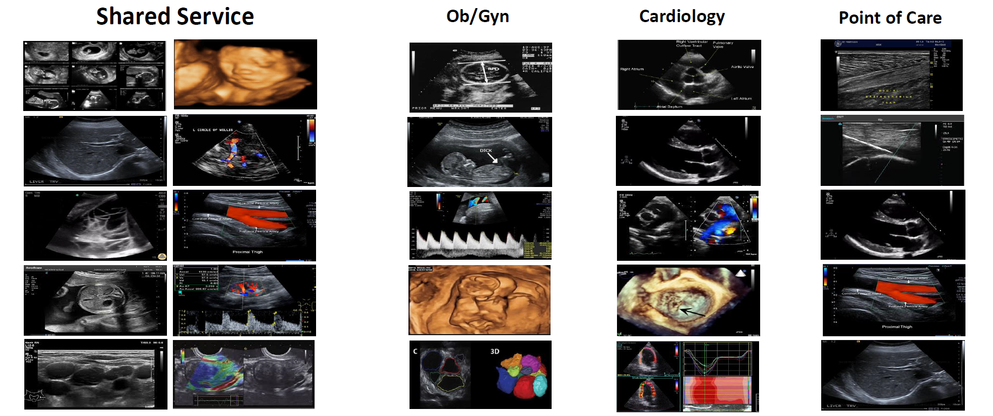
Market Segmentation

Slide 37
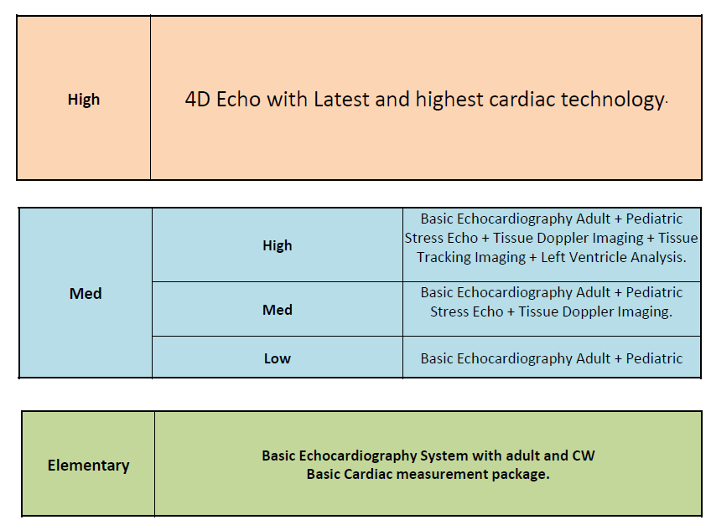
Cardiology

Slide 38
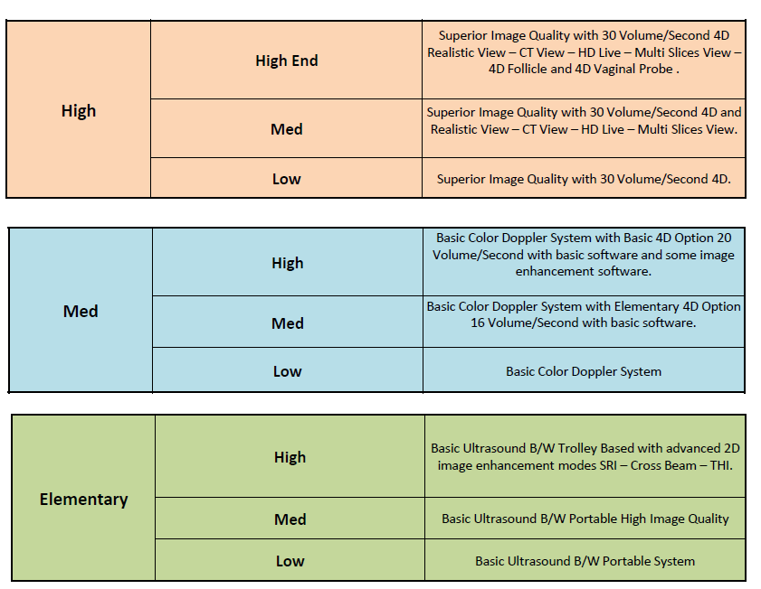
OB & GYN

Slide 39

Shared Service

Slide 40
Advanced Machines
Acuson juniper standby 3 sec low noise 26db
Redwood dependent on the tissue characteristics
Acuson Sequoia depth 40 cm Somo

Slide 41
References
The Handbook of Medical Technology
Biomedical Engineering Youtube channel by Dr. Yasser Kadah
SIG Medical Solutions

Slide 42
Mohamed Ahmed Abdelaziz
Systems And Biomedical
Engineering Department
3rd Year
Cairo University
(+20)01552516133
Mohamed.ahmed997@eng-st.cu.edu.eg

Slide 43
Thanks

